Slide 1
Longitudinal data Analysis
Longitudinal study: people are measured repeatedly over time
Cross-sectional study: a single outcome is measured for each individual In LDA, we can investigate: changes over time within individuals (ageing effects) differences among people in their baseline levels (cohort effects)
LDA requires special statistical methods because the set of observations on one subject tends to be inter-correlated

Slide 2
The Income Dynamics (PSID) Study
The Panel Study of Income Dynamics (PSID), begun in 1968, is a longitudinal study of a representative sample of U.S. individuals.
The study is conducted at the Survey Research Center, Institute for Social Research, University of Michigan and is still continuing.
The data that represents a small subset of this data is available in R software under the library faraway.
A data frame with 1661 observations on the following 6 variables is available in R under the library named faraway.
• age : age in 1968 • educ: years of education • sex : sex of individual, F or M
• income : annual income in dollars • year : calendar year • person: ID number for individual

Slide 3
A partial view of this data set can be obtained using the following
R code.
library(faraway) data(psid) mypsid<-subset (psid, (subset=(person <4))) mypsid1<-subset(mypsid, (subset=(year < 75))) mypsid1

Slide 4
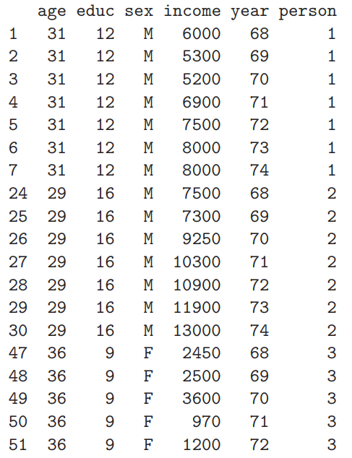

Slide 5
This data set indicates that repeated measurements are made for income variable. Thequestion of interest might be:
• Is there change in income over years? • Is there variation by sex?
The profile plots for 20 subjects can be obtained using the following
R code:
xyplot(income ~ year , psid, type="l", subset=( person < 20),strip=TRUE)

Slide 6
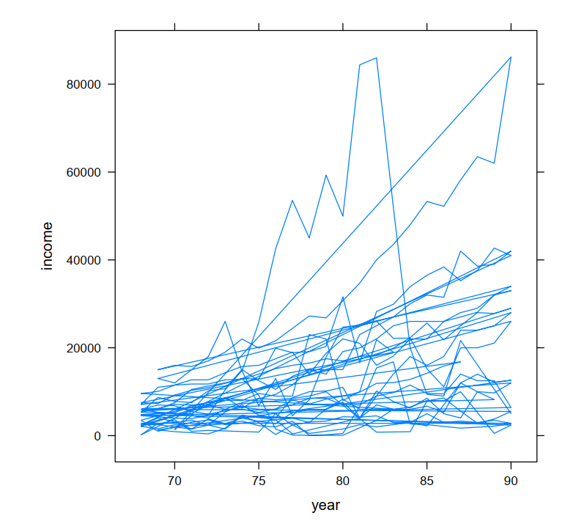
Subject Profiles of Income Data

Slide 7
Cont…
As can be seen from the above graph
• Some individuals have a slowly increasing income • Other individuals have more erratic incomes • Income may possibly vary by sex • There is small variation at the beginning than at the end • We may need profile plot by sex
The profile plot of income data by sex can be obtained using the following R code for part of the data.
xyplot(income ~ year | sex, psid, type="l", subset=( person < 500),strip=TRUE)

Slide 8
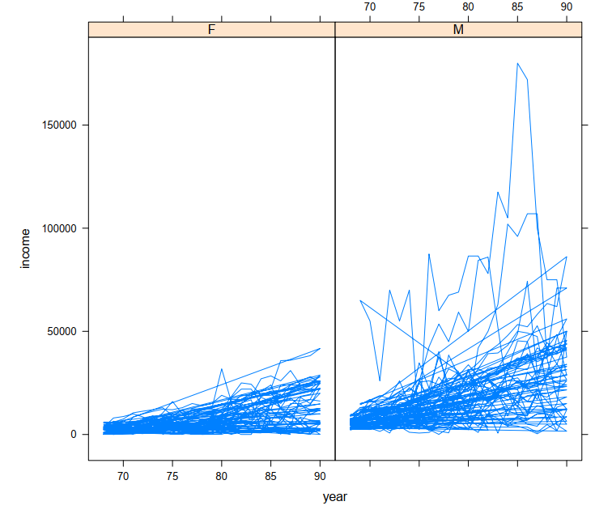
cont…
Subject Profiles of Income by Sex

Slide 9
Cont…
• The variation for males is higher than that of females. • The income data for males is more erratic • The variation at the beginning is smaller than the variation at the end for both groups.

Slide 10
The Orthodontic Growth Data Set
This data set is taken from Potthoff and Roy, Biometrika (1964). A set of measurements of the distance from the pituitary gland to the pterygo-maxillary fissure taken every two years from 8 years of age until 14 years of age on a sample of 27 children -16 males and 11 females.
The data, were collected by orthodontists from x-rays of the children’s skulls.
The individual profile plot and the mean profile for males and females separately are given below.

Slide 11
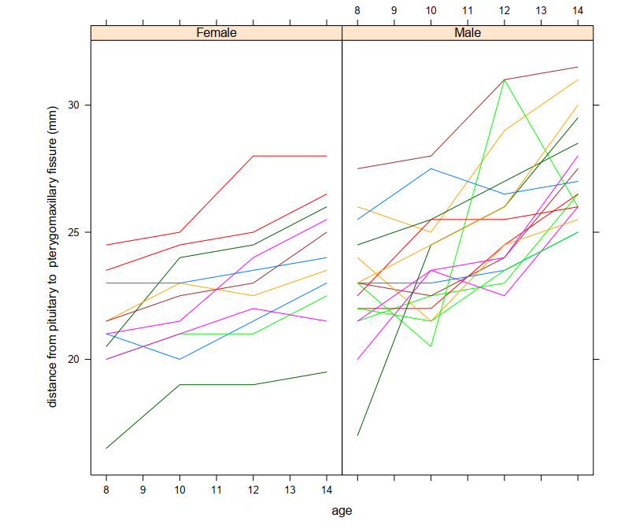
Subject Profiles of Orthodontic Growth Data

Slide 12
Cont…
• Much variability between children • There is considerable variability within Children • There are fixed number of measurements per subject • Measurements are taken at fixed time points • No issue of missing data
R-code library(lattice)
library(foreign)
dat<-read.table("C:\\growth.txt", header = TRUE, sep = "" )
growth<-dat
attach(growth)
age<-as.factor(age)
Sex<-as.factor(Sex)
xyplot(distance ~ age|Sex, growth, groups=Subject, type="l", xlab= " age ",
ylab=" distance from pituitary to pterygomaxillary fissure (mm) ")
mean1<-tapply(distance, age, mean)
age1<-as.numeric(unique(age))
plot(age1, mean1, type= "l",ylim=c(20,30), xlab="age",
ylab=" The mean distance", lwd=3, main=" The mean profile of the growth data set")

Slide 13
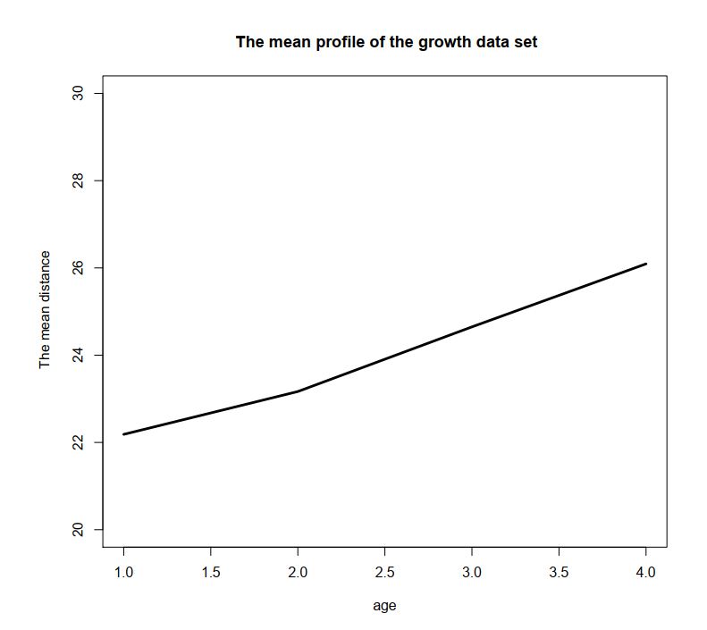
The relationship between age and distance appears to be linear

Slide 14
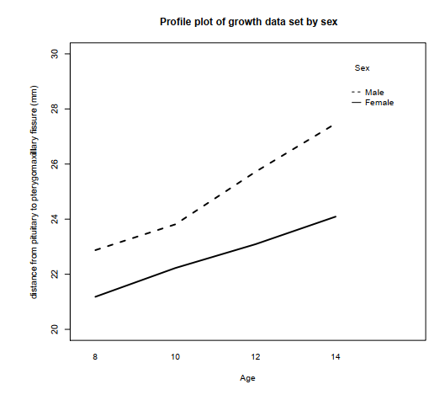
The Mean Distance Profile by Sex for Orthodontic Growth Data From the above figure : • It appears that there is a linear growth pattern • The mean profile for males is higher than that of females

Slide 15
Exploring the Variability of the Observed Data
It is to be recalled that the individual profile plots of the orthodontic data set, show a considerable within and between subject variability.
R-code
library(lattice) library(foreign) dat<-read.table("C:\\growth.txt", header = TRUE, sep = "" ) attach(dat) varg<- tapply( distance,age, var) names(varg) age1<-as.numeric(unique(age)) varg<-as.vector(varg) plot(age1, varg, type=’l’,main =" Observed variance ", xlab=’ age’, ylab=’The variance of distance’, lwd=3) interaction.plot(age, Sex, distance, lty=c(1, 2), fun=var, ylab="distance from pituitary to pterygomaxillary fissure (mm) ", xlab="Age", trace.label="Sex") title(main=" The variance of the growth data set by sex")

Slide 16
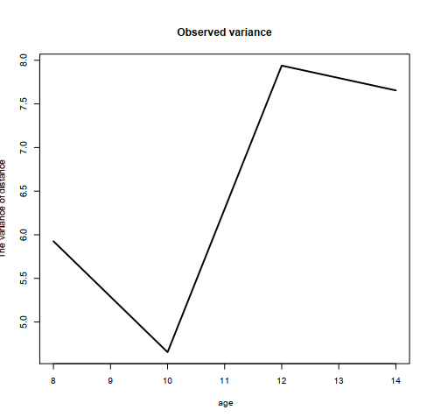
Cont…
The tapply function calculates the variance at each time point • The plot function in line 9 plots the variance versus age
The interaction plot is used to plot the variance functions separated for males and females. Variability of the Observed Orthodontic Distance

Slide 17
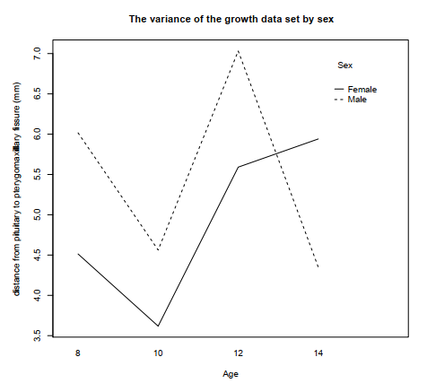
Cont…
It appears the observed variance is not constant • We consider the observed variance by sex • The variability for males is higher than that of females from age 8 to 12
Variability of the Observed Orthodontic Distance by Sex

Slide 18
Cont…
Having repeated observations on individuals allows direct study of change (normal growth and aging).
Can separate aging effects (changes over time within individuals) from cohort effects (differences between subjects at baseline)
Require sophisticated statistical techniques since the repeated observations are usually correlated.
Certain types of correlation structures are likely to arise from this kind of data. Correlation must be accounted for to obtain valid inference.
Subjects serve as their own control which economizes on subjects and reduces unexplained variability in the response.
Robust to missing data and irregularly spaced measurement occasions (only if Mixed effect modeling was used)

Slide 19
Cont…
Spaghetti plots (overall, by treatment or other covariates of interest) Box-plots by time (overall, by treatment or other covariates of interest)
Mean profiles (overall, by treatment or other covariates of interest) Scatterplot Matrix of the response at the different time points.

Slide 20
A model for Longitudinal Data
Linear mixed models (LMM) are models that handle data where observations are not independent.
That is, LMM correctly models correlated errors, whereas procedures in the general linear model family (GLM) usually do not. (GLM includes such procedures as t-tests, analysis of variance, correlation, regression, and factor analysis, to name a few.)
LMM can be considered as a further generalization of GLM to better support analysis of a continuous response.
Mixed models contain both fixed and random effects.
These models are useful in a wide variety of disciplines in the physical, biological and economic sciences.
They are particularly useful in settings where repeated measurements are made on the same statistical units, or where measurements are made on clusters of related statistical units.
Let us see some of the terms associated with mixed models.

Slide 21
Cont…
Fixed Effects: factors for which the only levels under consideration are contained in the coding of those effects.
Sex where both male and female genders are included in the factor, is fixed effect.
Agegroup: Minor and Adult are both included in the factor of agegroup is considered as fixed effect.
Random Effects: factors for which the levels contained in the coding of those factors are a random sample of the total number of levels in the population for that factor.
A Subject which is a random sample of the target population can be considered as random.
Through random effects models, the researcher can make inferences over a wider population in LMM than possible with GLM.

Slide 22
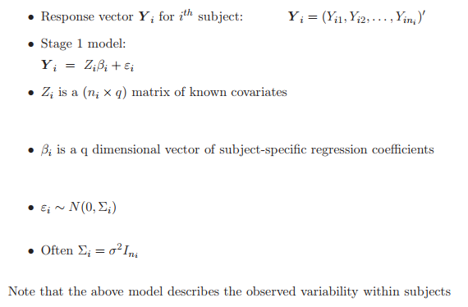
Stage 1

Slide 23
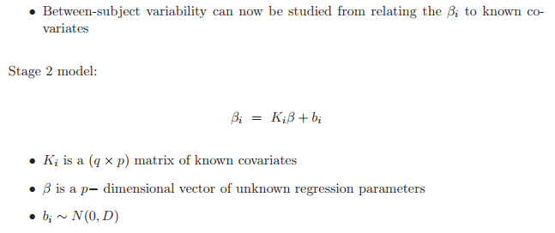
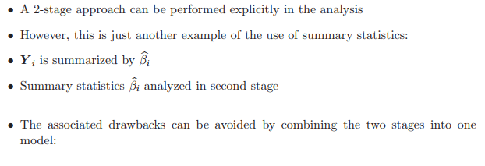
The General Linear Mixed-effects Model

Slide 24
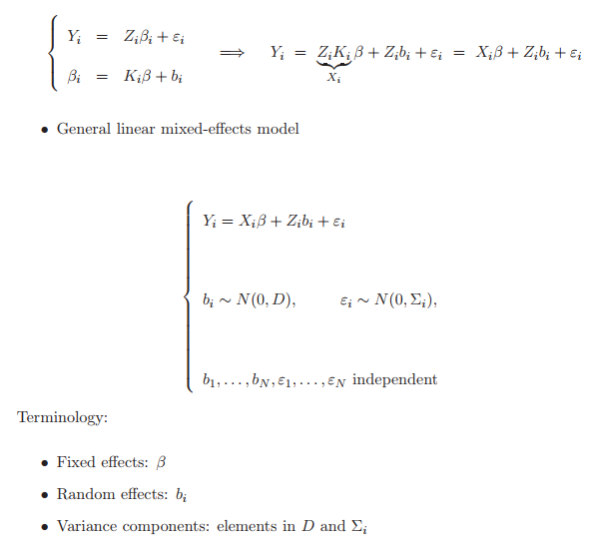
Cont…

Slide 25
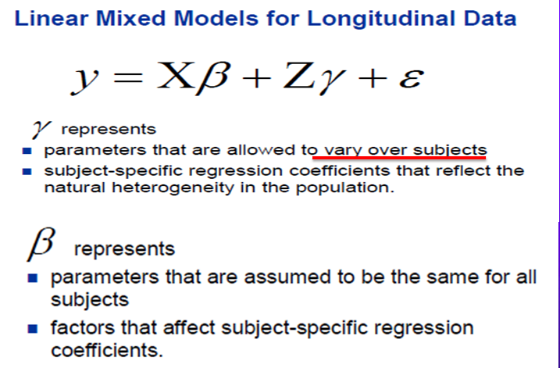

Slide 26
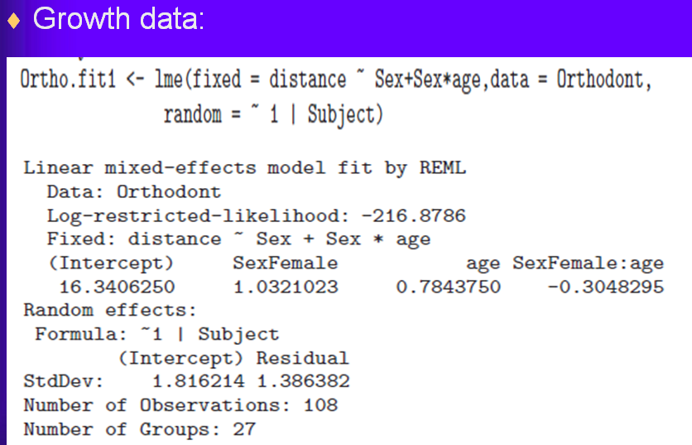

Slide 27
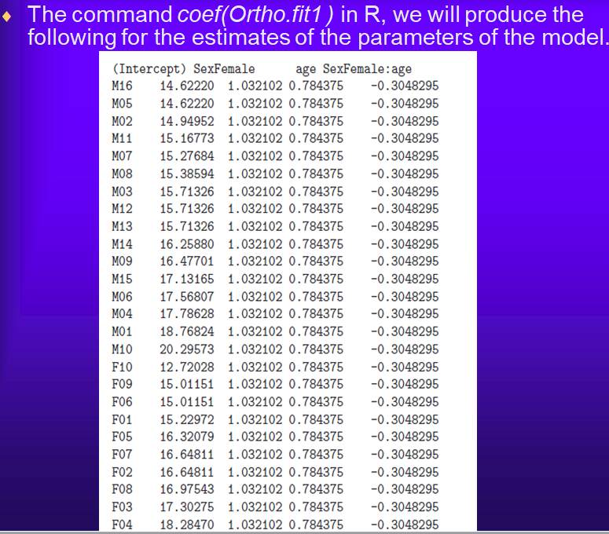

Slide 28
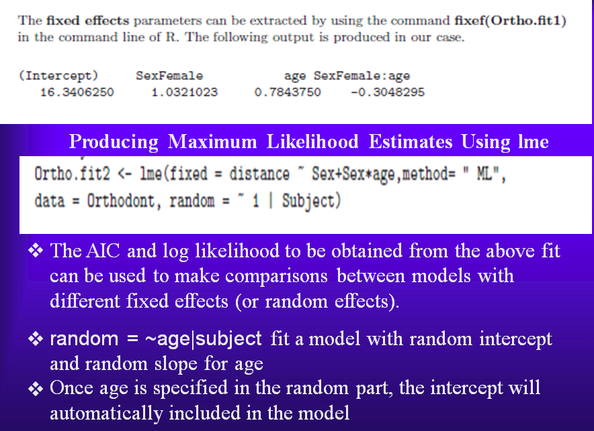

Slide 29
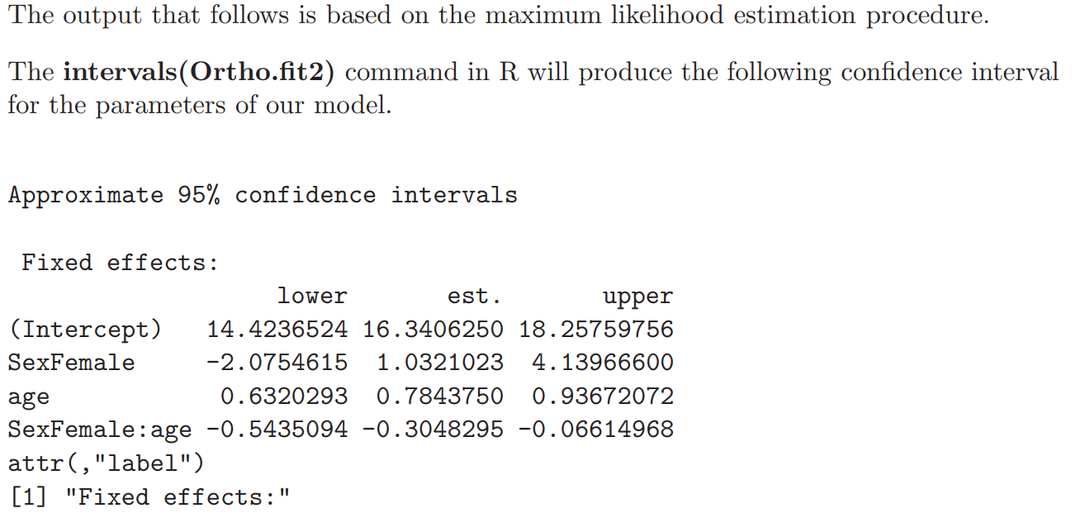

Slide 30
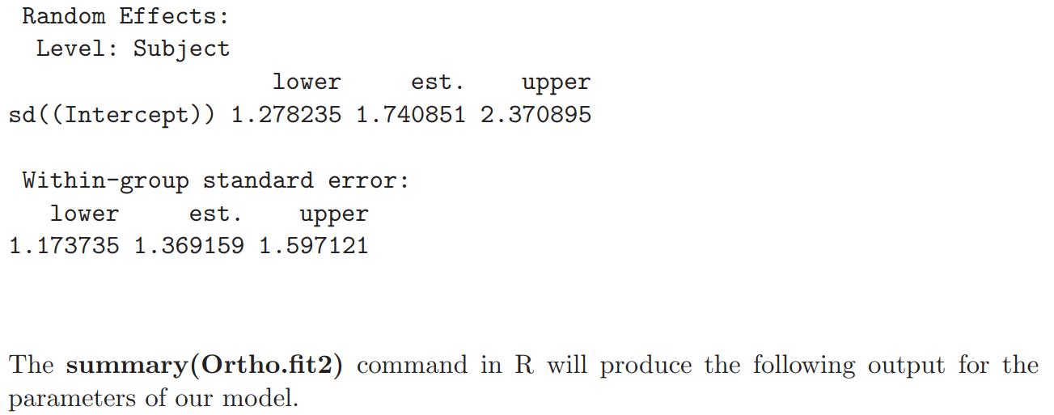

Slide 31
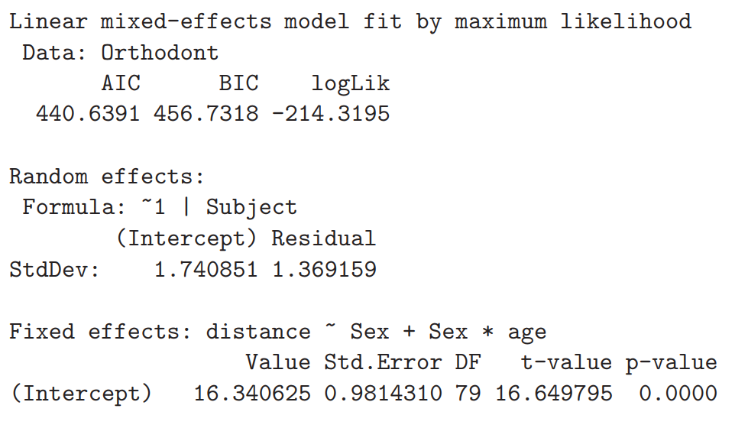

Slide 32
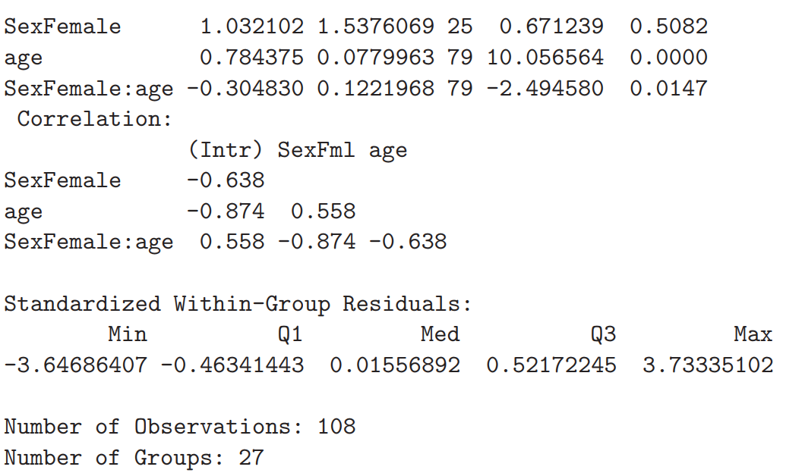

Slide 33
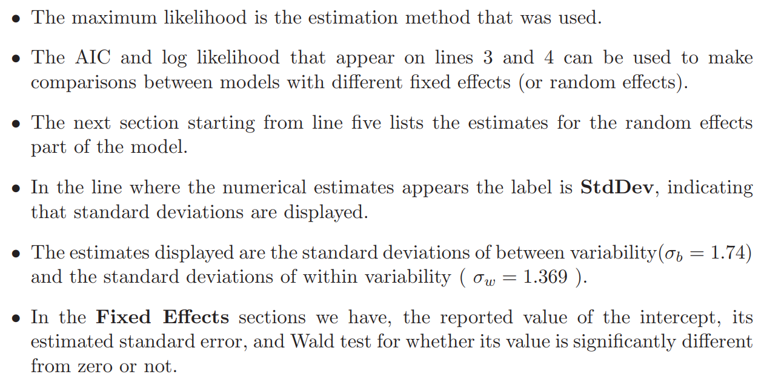

Slide 34
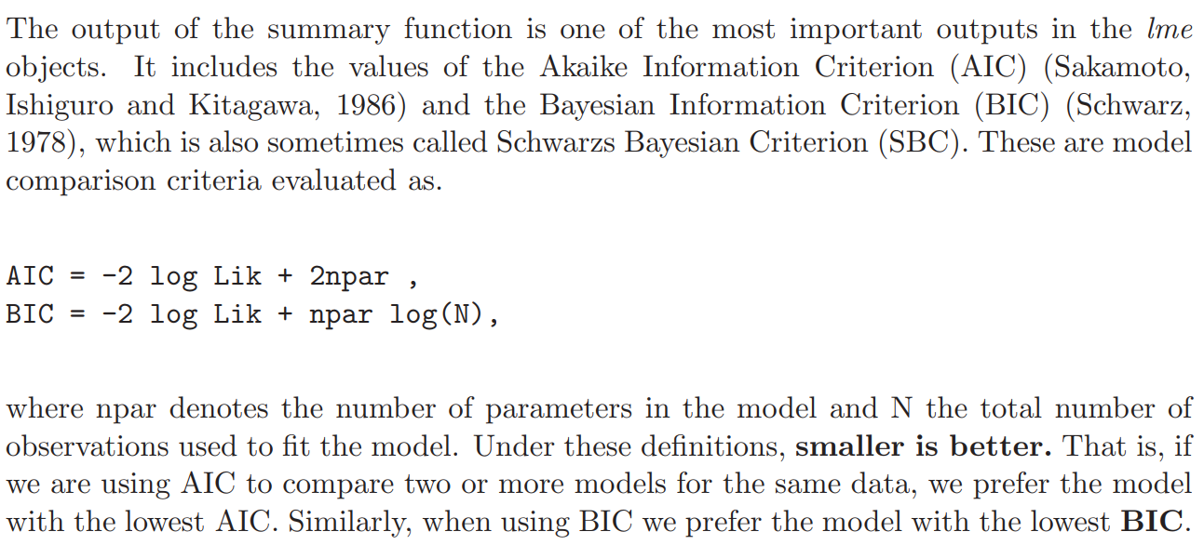

Slide 35
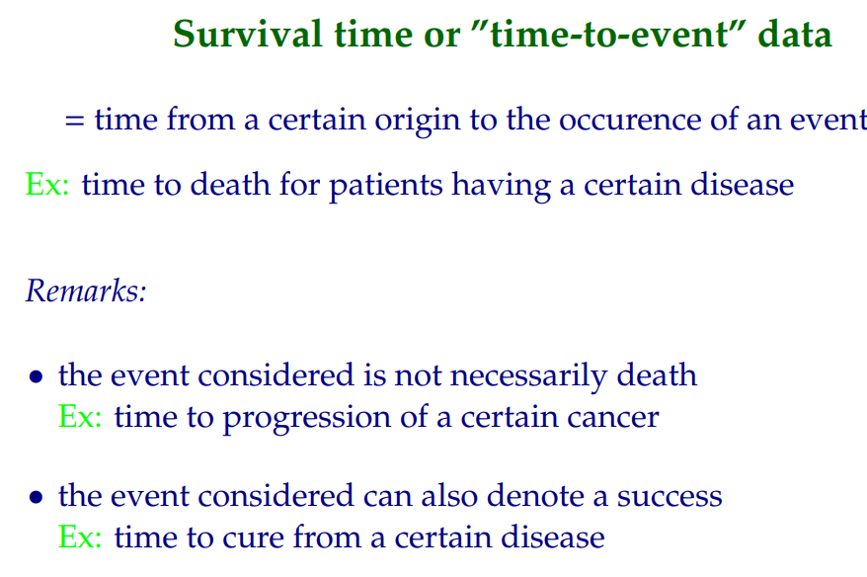
Introduction to Survival Analysis

Slide 36
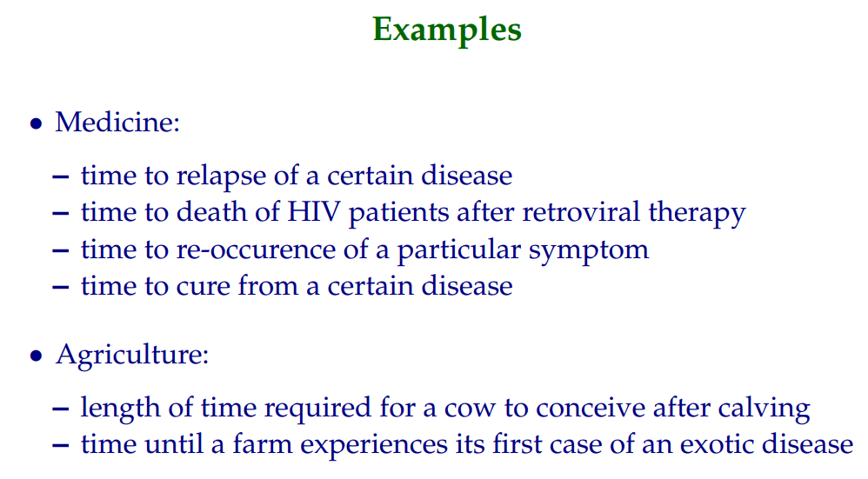

Slide 37
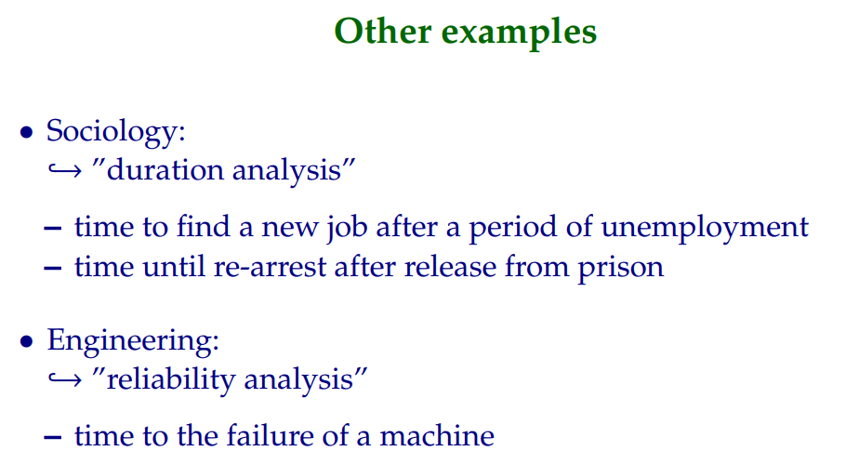

Slide 38
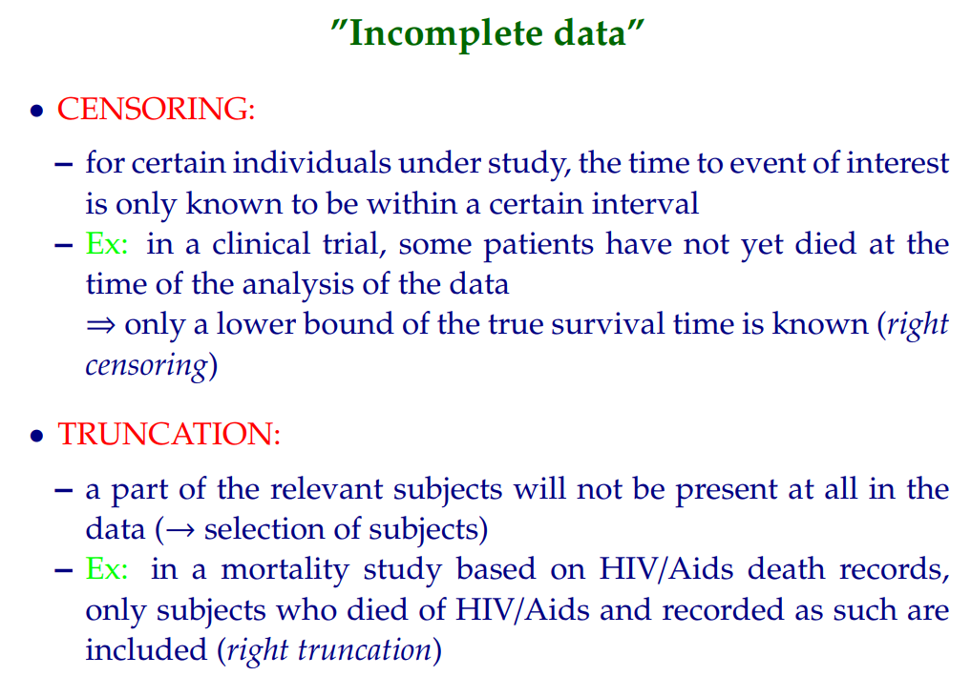

Slide 39
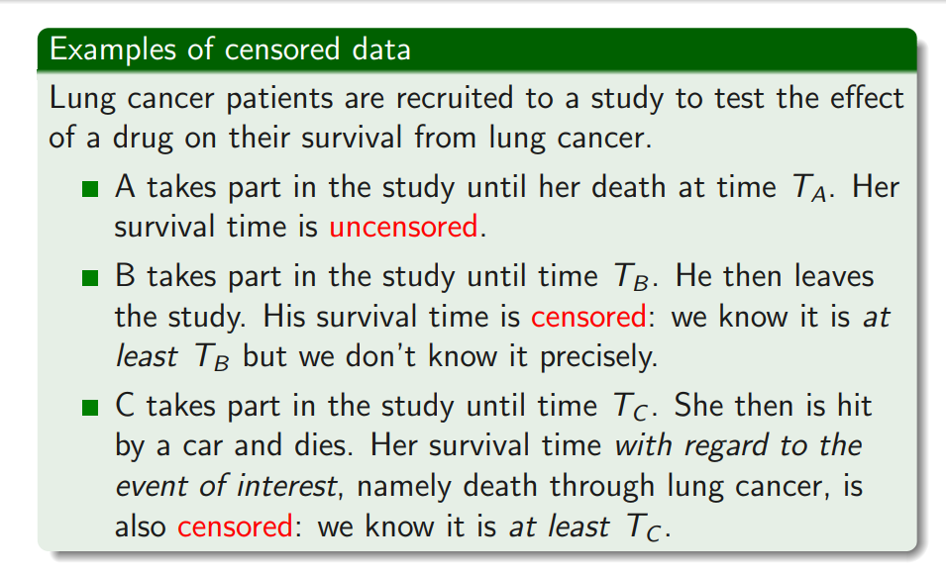

Slide 40
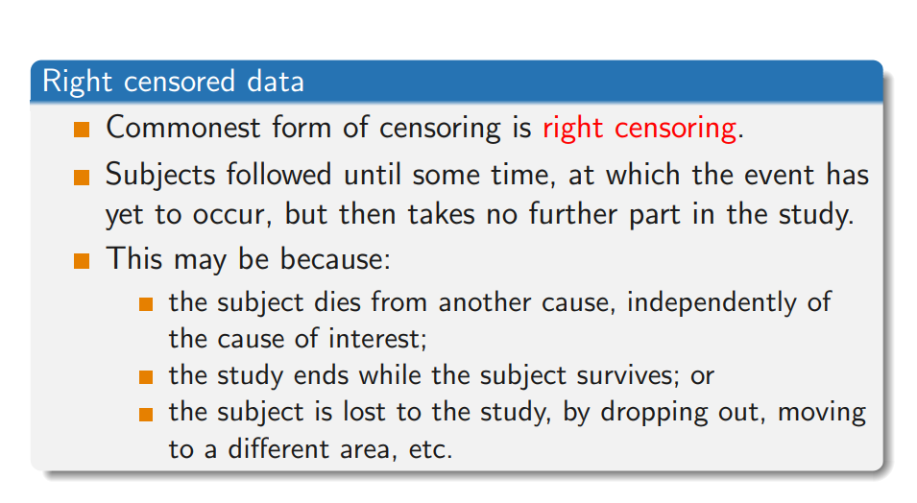

Slide 41
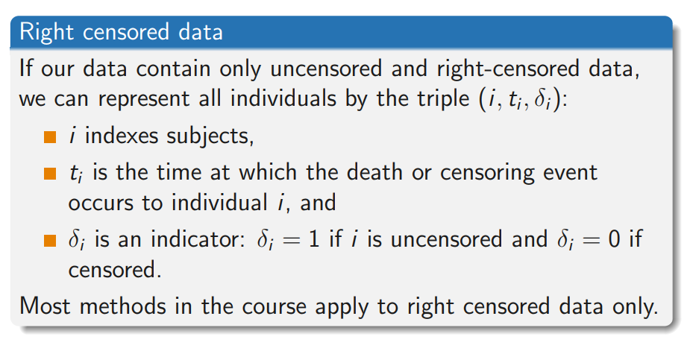

Slide 42
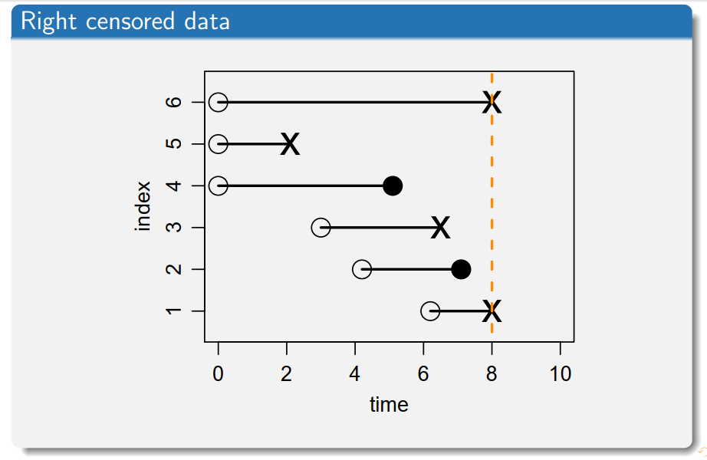

Slide 43
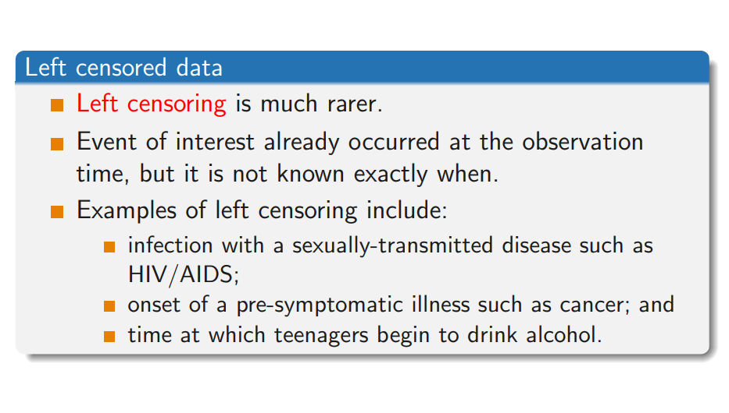

Slide 44

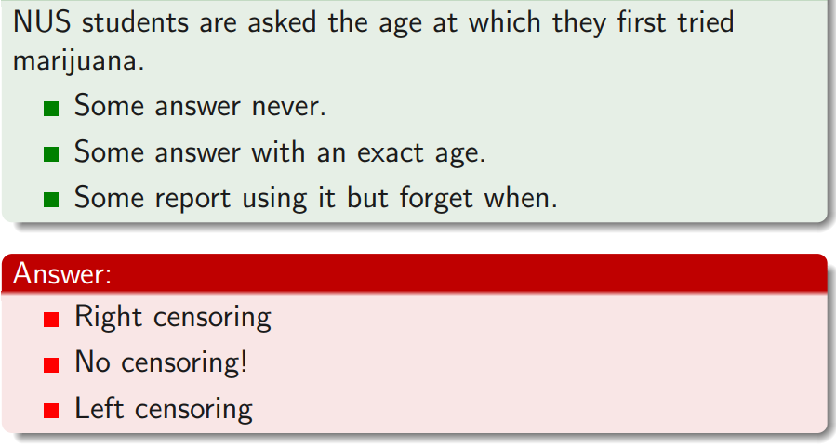

Slide 45


Slide 46
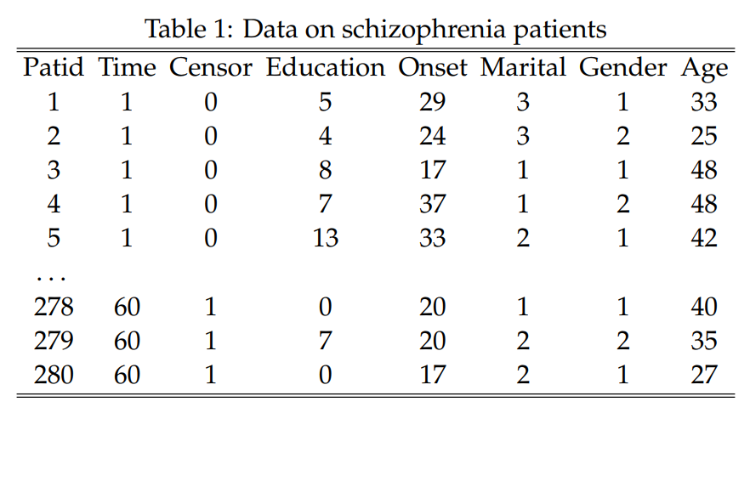

Slide 47
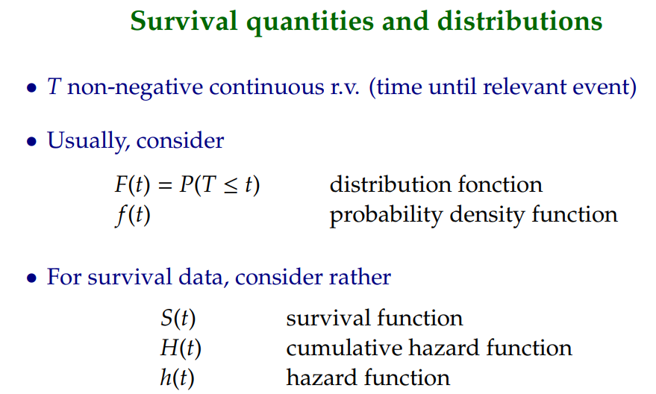

Slide 48
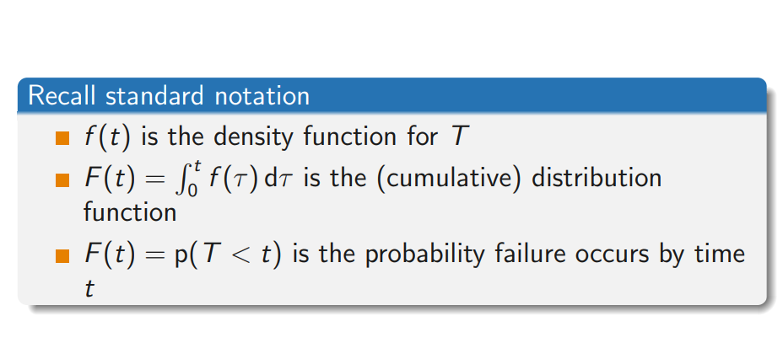

Slide 49
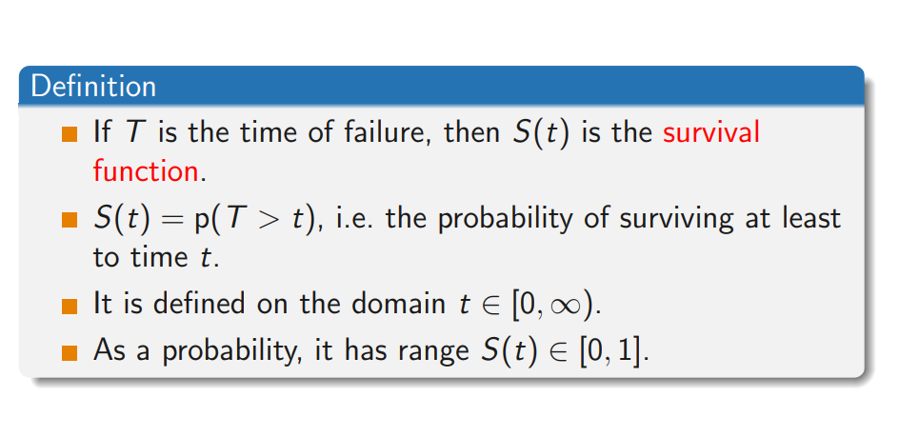

Slide 50
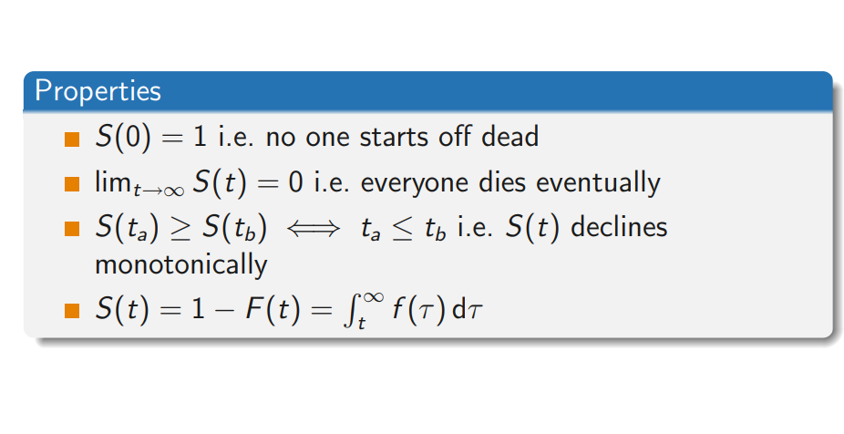

Slide 51
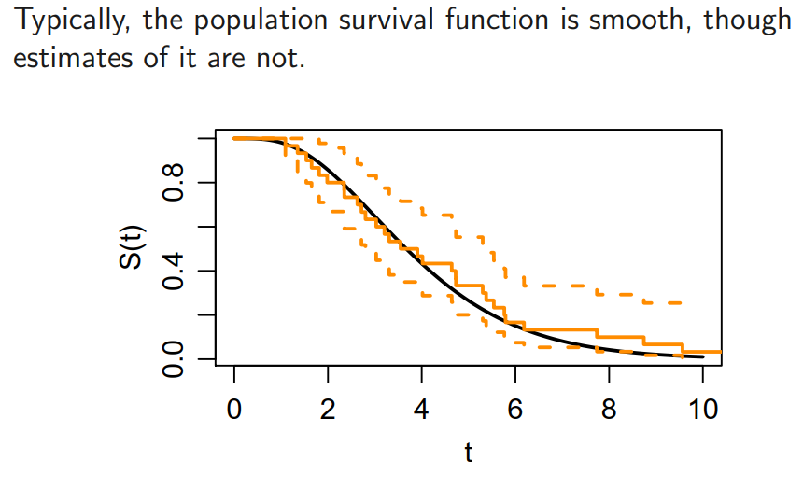

Slide 52
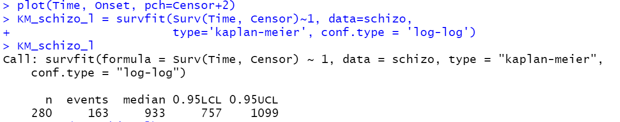
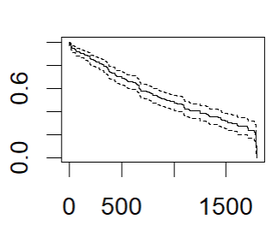

Slide 53
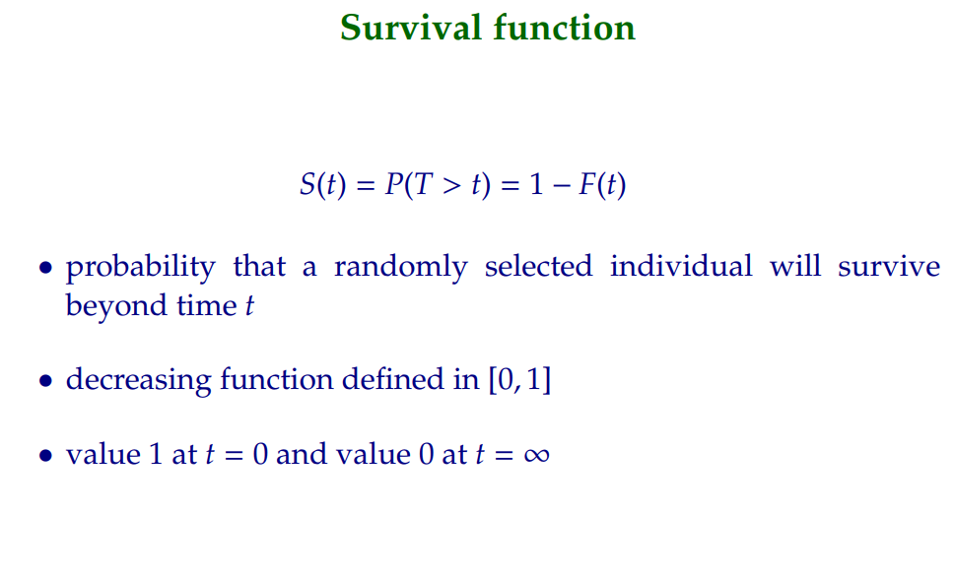
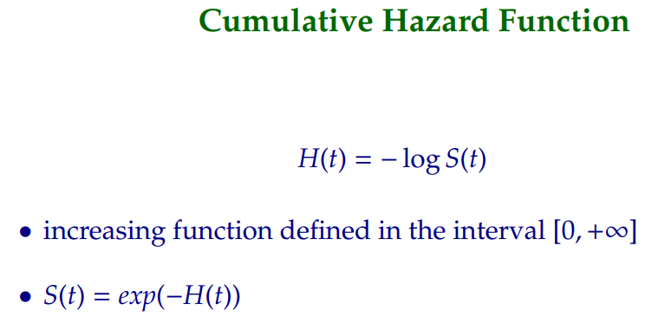

Slide 54
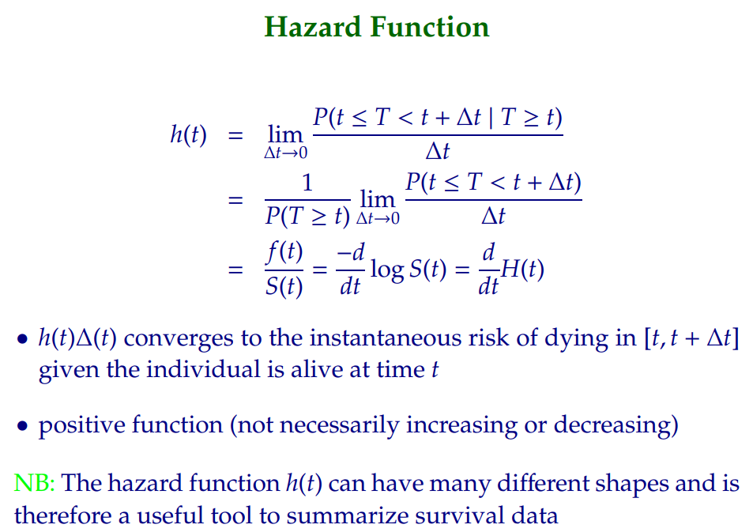

Slide 55

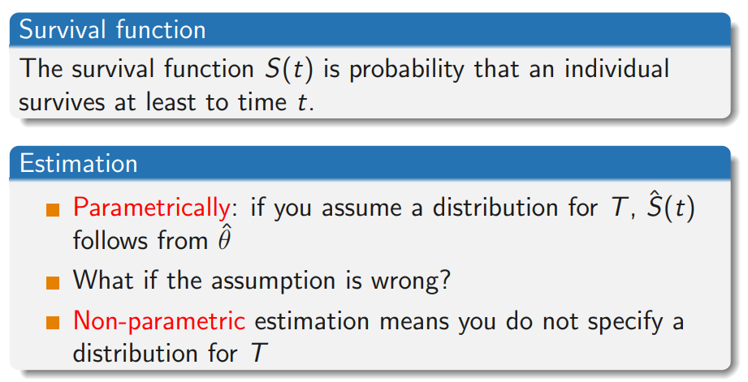

Slide 56
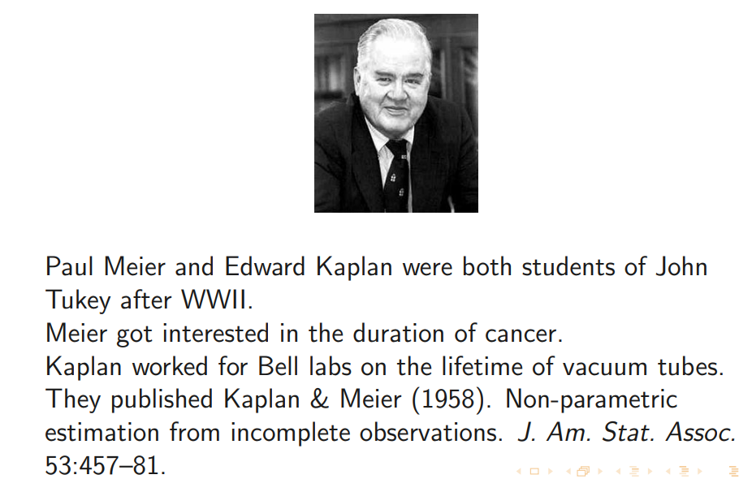

Slide 57
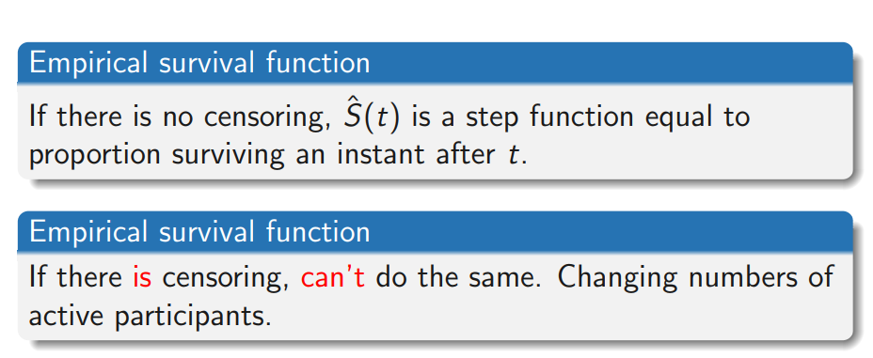

Slide 58
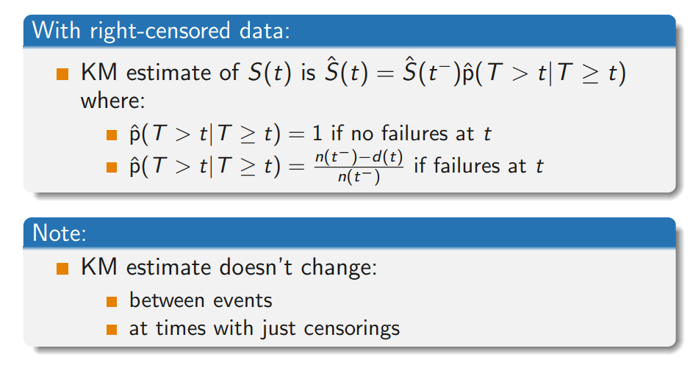

Slide 59
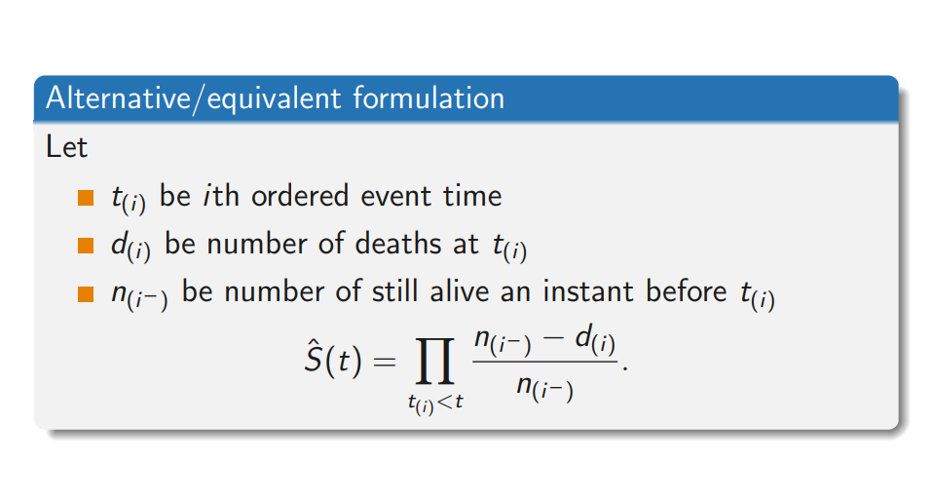

Slide 60

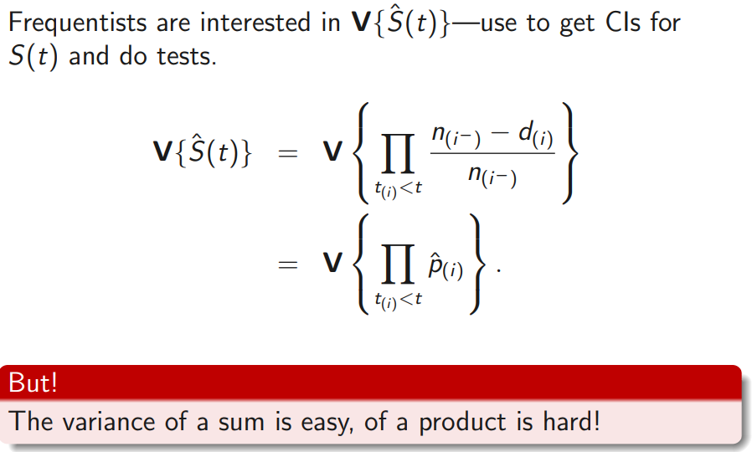

Slide 61
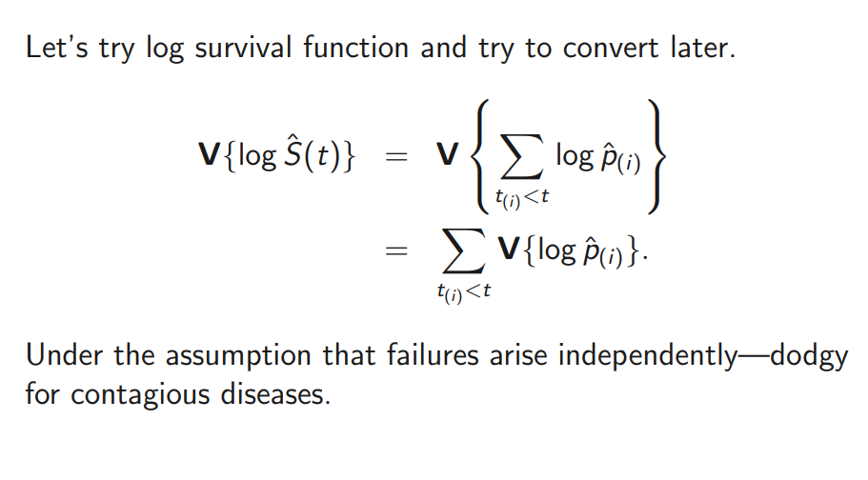

Slide 62



Slide 63


Slide 64



Slide 65



Slide 66



Slide 67


Slide 68


Slide 69


Slide 70


Slide 71
Gender clearly is associated with an effect on survival (not necessarily causal).
Age has no impact upon survival.

Slide 72


Slide 73



Slide 74


Slide 75



Slide 76



Slide 77


Slide 78



Slide 79



Slide 80


Slide 81



